Slide 1
Matrix Algebra
THE LEONTIEF INPUT-OUTPUT MODEL

Slide 2
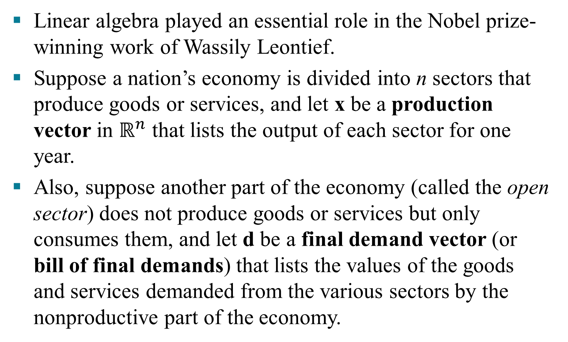
THE LEONTIEF INPUT-OUTPUT MODEL
Linear algebra played an essential role in the Nobel prize-winning work of Wassily Leontief.
Suppose a nation’s economy is divided into n sectors that produce goods or services, and let x be a production vector in $ℝ^{n}$ that lists the output of each sector for one year.
Also, suppose another part of the economy (called the open sector) does not produce goods or services but only consumes them, and let d be a final demand vector (or bill of final demands) that lists the values of the goods and services demanded from the various sectors by the nonproductive part of the economy.

Slide 3
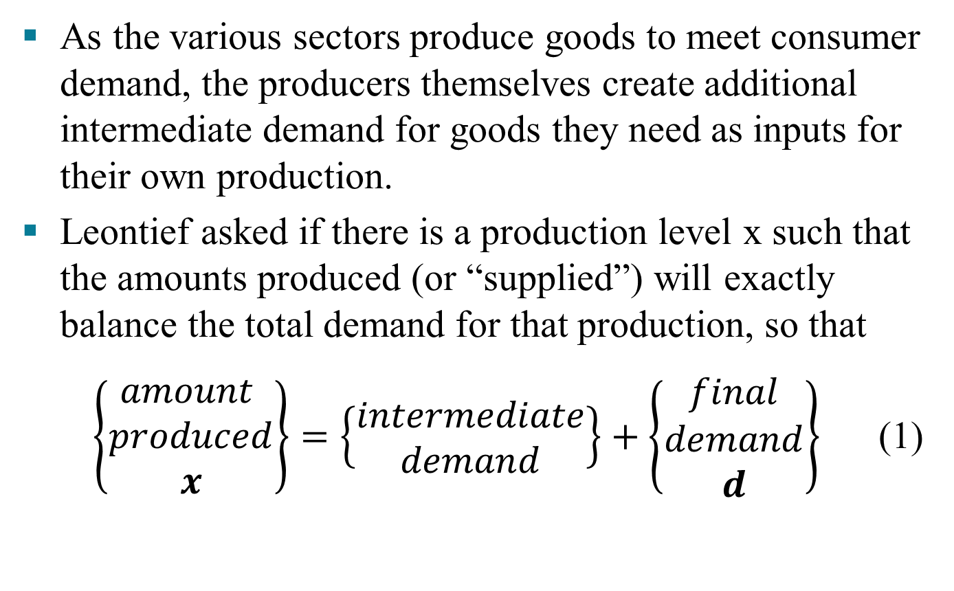
THE LEONTIEF INPUT-OUTPUT MODEL
As the various sectors produce goods to meet consumer demand, the producers themselves create additional intermediate demand for goods they need as inputs for their own production.
Leontief asked if there is a production level x such that the amounts produced (or “supplied”) will exactly balance the total demand for that production, so that
$\left\{\begin{aligned}amount \\ produced \\ x\end{aligned}\right\}=\left\{\begin{aligned}intermediate \\ demand\end{aligned}\right\}+\left\{\begin{aligned}final \\ demand \\ d\end{aligned}\right\}$ (1)

Slide 4
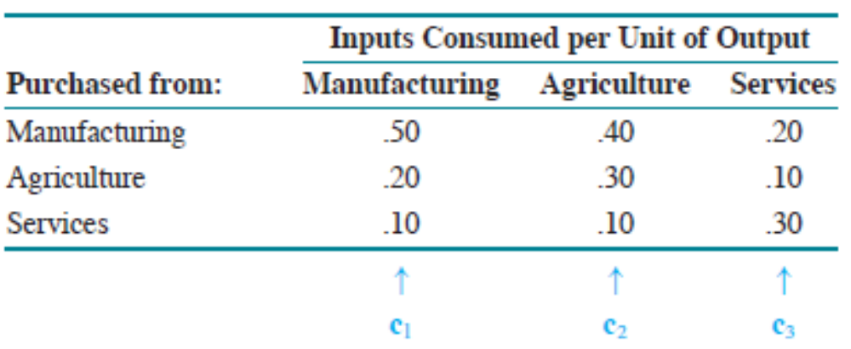
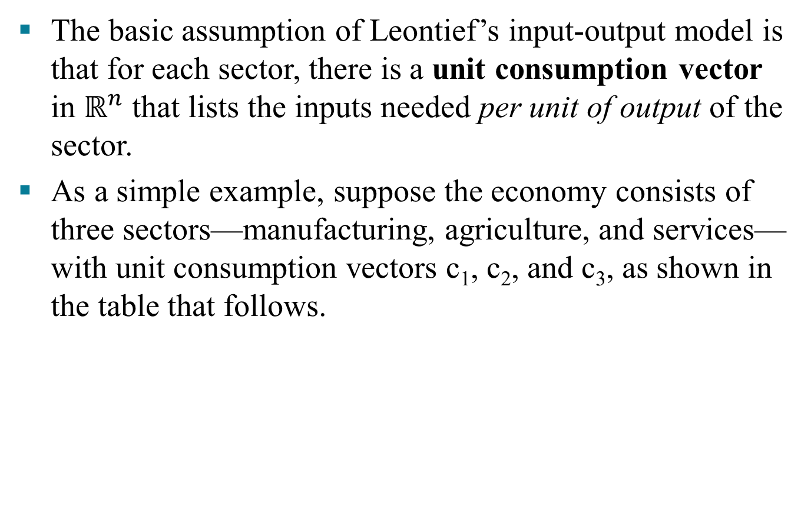
THE LEONTIEF INPUT-OUTPUT MODEL
The basic assumption of Leontief’s input-output model is that for each sector, there is a unit consumption vector in $ℝ^{n}$ that lists the inputs needed per unit of output of the sector.
As a simple example, suppose the economy consists of three sectors—manufacturing, agriculture, and services—with unit consumption vectors c₁, c₂, and c₃, as shown in the table that follows.

Slide 5
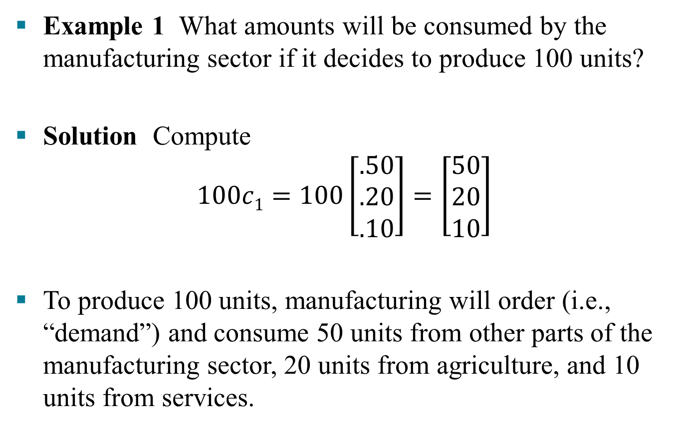
THE LEONTIEF INPUT-OUTPUT MODEL
Example 1 What amounts will be consumed by the manufacturing sector if it decides to produce 100 units?
Solution Compute
$$100c1=100\left[\begin{aligned}.50 \\ .20 \\ .10\end{aligned}\right]=\left[\begin{aligned}50 \\ 20 \\ 10\end{aligned}\right]$$
To produce 100 units, manufacturing will order (i.e., “demand”) and consume 50 units from other parts of the manufacturing sector, 20 units from agriculture, and 10 units from services.

Slide 6
THE LEONTIEF INPUT-OUTPUT MODEL
If manufacturing decides to produce x₁ units of output, then x₁c₁ represents the intermediate demands of manufacturing, because the amounts in x₁c₁ will be consumed in the process of creating the x₁ units of output.
Likewise, if x₂ and x₃ denote the planed outputs of the agriculture and services sectors, x₂c₂ and x₃c₃ list their corresponding intermediate demands.

Slide 7
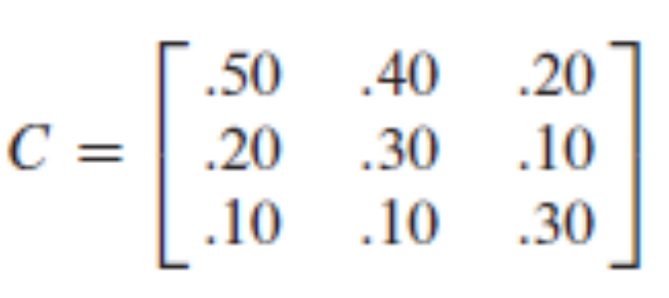
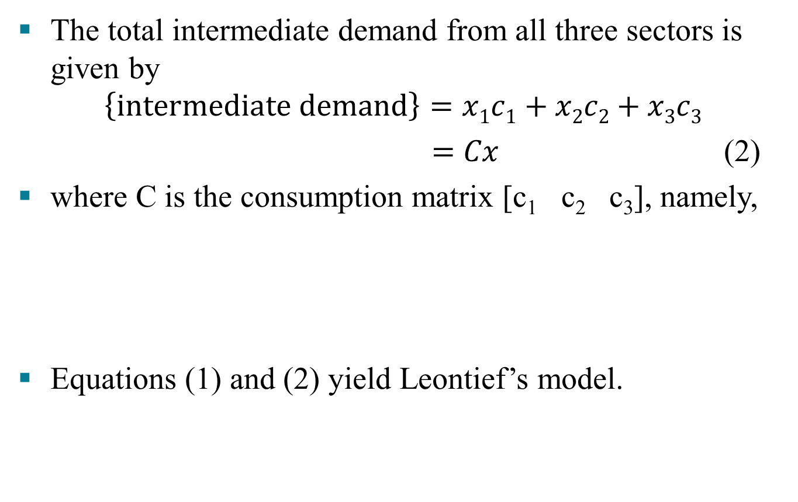
THE LEONTIEF INPUT-OUTPUT MODEL
The total intermediate demand from all three sectors is given by
$$\left\{intermediate demand\right\}=x1c1+x2c2+x3c3$$
$=Cx$(2)
where C is the consumption matrix [c₁ c₂ c₃], namely,
Equations (1) and (2) yield Leontief’s model.
(3)
x = Cx + d
(4)
Amount produced
Intermediate demand
Final Demand

Slide 8
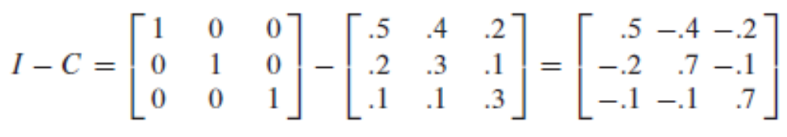
THE LEONTIEF INPUT-OUTPUT MODEL
Equation (4) may also be written as Ix – Cx = d, or
(I – C)x = d
Example 2 Consider the economy whose consumption matrix is given by (3). Suppose the final demand is 50 units for manufacturing, 30 units for agriculture, and 20 units for services. Find the production level x that will satisfy this demand.
Solution The coefficient matrix in (5) is
(5)

Slide 9
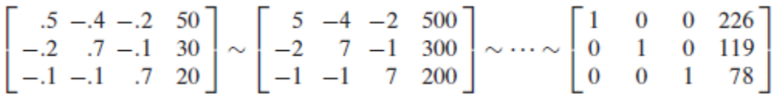
THE LEONTIEF INPUT-OUTPUT MODEL
To solve (5), row reduce the augmented matrix
The last column is rounded to the nearest whole unit. Manufacturing must produce approximately 226 units, agriculture 119 units, and services only 78 units.

Slide 10
THE LEONTIEF INPUT-OUTPUT MODEL
In the theorem, the term column sum denotes the sum of the entries in a column of a matrix. Under ordinary circumstances, the column sums of a consumption matrix are less than 1 because a sector should require less than one unit’s worth of inputs to produce on unit of output.
Theorem 11: Let C be the consumption matrix for an economy, and let d be the final demand. If C and d have nonnegative entries and if each column sum of C is less than 1, then (I – C)⁻¹ exists and the production vector
x = (I – C)⁻¹d
has nonnegative entries and is the unique solution of
x = Cx + d

